Slide 1
Simplified Data Structure
Presentation
on
Project Guide: Prof.Snehal Gavale
Group Members-
11-Kaushal Choudhari
35-Samartha Mhatre
38-Pratik Nivalkar
45-Shrawani Rithe

Slide 2
OUTLINE OF PRESENTATION
Introduction
Literature survey
Problem Statement
Algorithm
Flowchart
Pro’s & Con’s
Result
Future Scope
Conclusion
References

Slide 3
Introduction
Data Structure Visualizer is an Software that is designed and developed for students and lecturers.
The system helps students to visualize and practice.
It also helps lecturers to upload the competitive programming-based questions and answers in the database and they can see the students who fail or pass in Data Structures.
All the data structures available in one place and the user can learn everything at a single place.

Slide 4
Literature Review
 | TITLE | AUTHOR | OVERVIEW
1 | Visualizing data Structures in an e-learning System. | Michael Striiewe | This paper describes the efficiency of e-learning Platform.
2 | A tool for data Structure Visualization and user-defined Algorithm Animation. | Rita t Lee m Sliver | This paper describes the useful tools for Animation purpose.

Slide 5
Problem statement
It becomes quite confusing and tedious to visualize things on our own since abstract thinking plays a crucial role in forming its conceptual model in our mind.
Thus, a need for a tool for visualizing the data structure algorithms interactively so that the student can experiment and learn as need arises.
We therefore made Data Structure visualizer to provide command toolbar , input and output panel , error panel , variable content display panel for users understanding and easy implementation of data structure algorithms.

Slide 6
Algorithm
Step 1: Start
Step 2: Open the website.
Step 3: various Data structure algorithm will appear.
Step 3: Select which data structure topic you want to learn.
Step 4: selected data structure page will appear in a visualize manner.
Step 5: Various quiz questions will pop up to test the ability of the user
Step 6: The user can also practice coding skills with the help of ide complier which is provided on the website.
Step 7: End

Slide 7
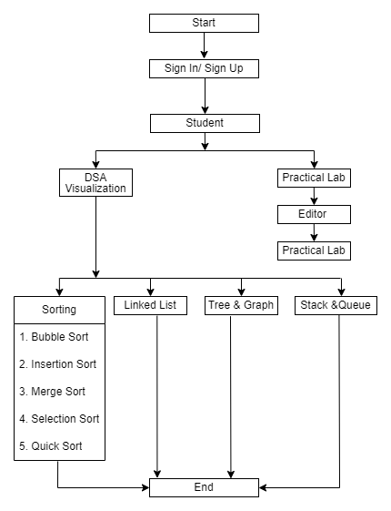
FlowChart

Slide 8
PROS
CONS
Can Perform activities on Data Structure anytime, anywhere.
Free of cost.
Education with entertainment .
Fast and efficient.
Requires an internet connection.
No live streaming of Lectures.
Cannot download content.

Slide 9
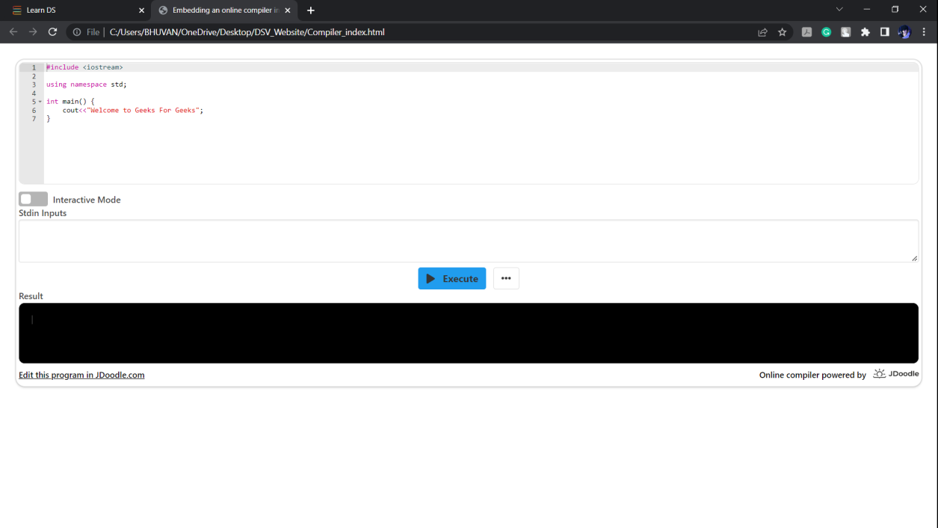
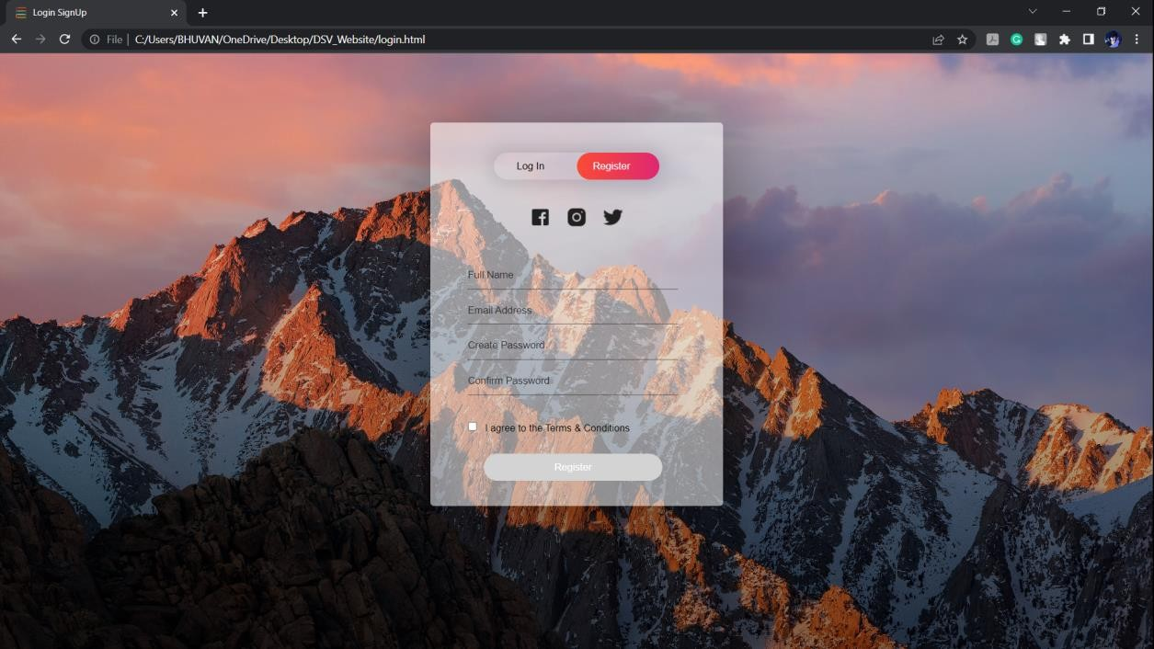
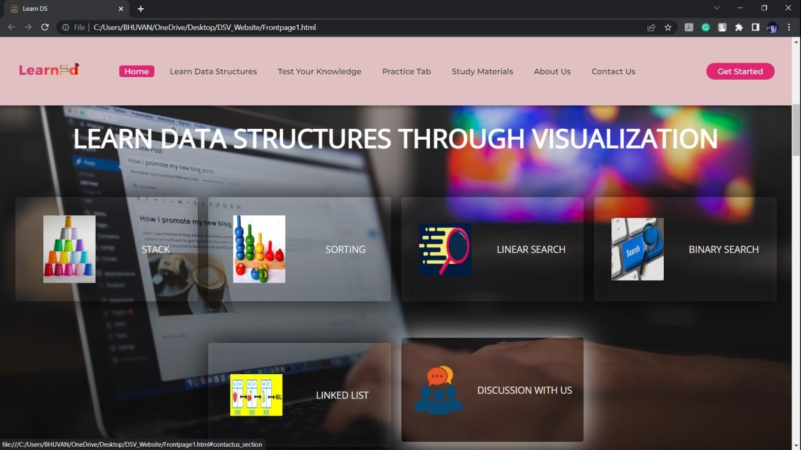
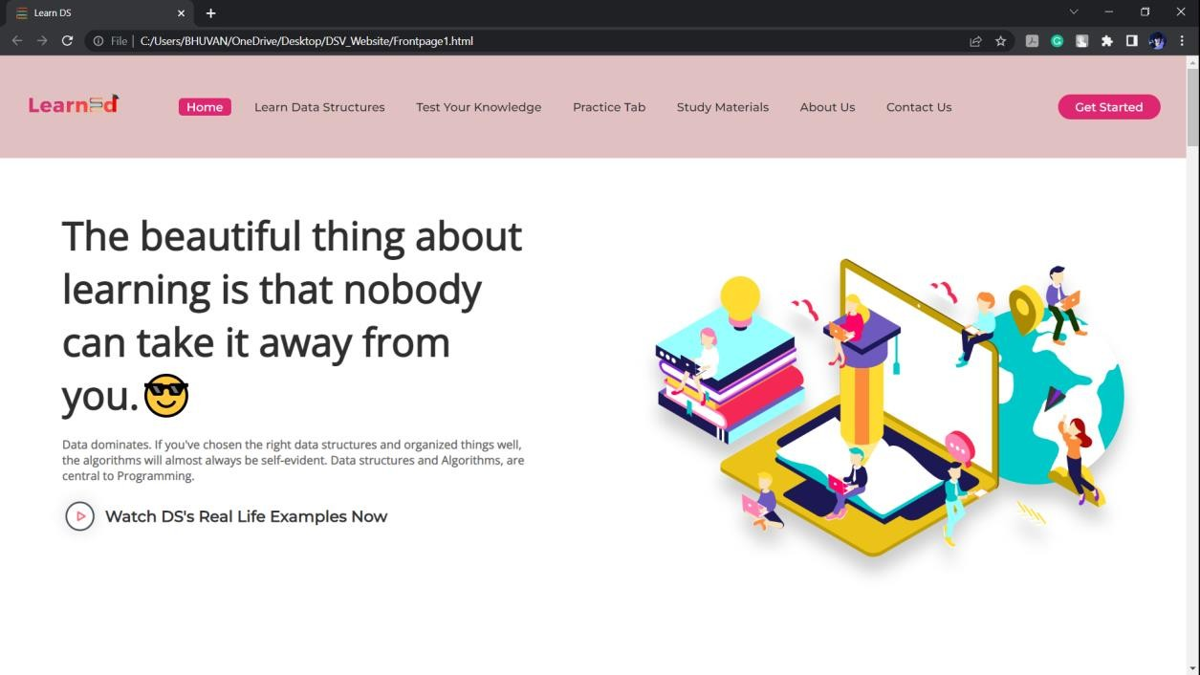
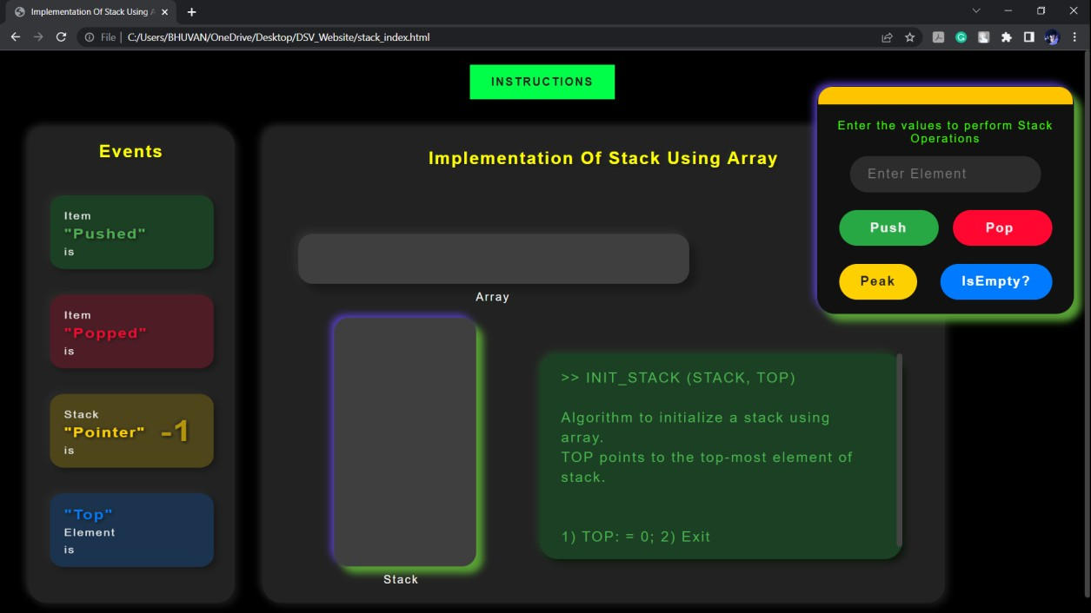
Results

Slide 10
Future Scope
To integrate Program visualization and algorithm visualization tool together.
Making an Application for our Website .

Slide 11
Conclusion
Thus we have implemented our project “Data Structure Visualizer”.
The whole project provides a base for students to take their exam using software and allow lecturers to add questions and answers into the system.
This Automated system helps students and lecturers to save time and makes the process faster, with a user-friendly system that has security, integrity and the database is neither inconsistent nor redundant.
In Future, the project can be enhanced by making it more interactive and by adding more features.

Slide 12
References
[1] L. Itti, C.Koch, and E. Niebur, ‘A model of saliency-based visual attention for rapid scene analysis,’ IEEE Transactions on Pattern Analysis and Machine Intelligence, Nov. 1998, vol. 20, no. 11, pp. 1254–1259
[2] Morris, John, “Programming Languages and Data Structures”, http://swww.ee.uwa.edu.au/~plsd210/ds/ds_ToC.ht ml
[3] Cawsey, Alison, “Data Structures and Algorithms”, http://www.cee.hw.ac.uk/~alison/ds98/ds98.html
[4] Owens, Brad “CS300 Data Structures and Algorithms I”, http://www.cs.twsu.edu/~bjowens/cs300/

Slide 13
Thankyou

